Slide 1
CMPE 255 Short Story Assignment

Slide 2
About the Paper
Paper Link : https://ieeexplore.ieee.org/document/9392067
Paper Title : Graduates Profile Mapping based on Job Vacancy Information Clustering
Published in: 2020 6th International Conference on Science in Information Technology (ICSITech)
Date of Conference: 21-22 Oct. 2020
Date Added to IEEE Xplore: 05 April 2021

Slide 3
Authors
Rani Megasari
Erna Piantari
Rizki Nugraha

Slide 4
Purpose of the Paper
The paper proposes a solution using clustering as a text mining technique to cluster the social media data related to the job vacancies and map vacancies to the eligible graduates.
The purpose is to find a specific pattern related to the profile of graduates often demanded by companies such that the graduates search for talents within their alma mater

Slide 5
Data
collected from communication medias within the Computer Science Education Department of FPMIPA UPI.
Data used in this research are a collection of descriptions of job vacancies in Indonesian. If written in English, then it will be translated first.

Slide 6
Steps that are performed

Slide 7
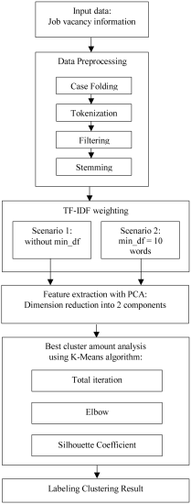

Slide 8
Data Preprocessing
Case Folding : to change preliminary data into cleaner data, for example uniforming capital letters into lowercase, removing numbers, punctuation, and emails on a job vacancy
Tokenization : to break down a sentence into individual words.
Filtering : to filter words that are considered to be unimportant (stop words) from data inputs.
Stemming : to remove affixes in a word to turn it into its base form

Slide 9
TF-IDF
TF*IDF algorithm is used to weigh a keyword in any content and assign importance to that keyword based on the number of times it appears in the document.
Scenario 1 : Without Min_df
Scenario 2 : min_df = 10 words

Slide 10
Feature Extraction with PCA
Principal Component Analysis, or PCA, is a dimensionality-reduction method that is often used to reduce the dimensionality of large data sets, by transforming a large set of variables into a smaller one that still contains most of the information in the large set
Dimension reduction into 2 components

Slide 11
K-Means Clustering
1. Initialize number of cluster, k-cluster.
2. Randomly select k-data as centroid of each cluster
3. Calculate the distance of each data to all centroid, the closest distance determines cluster membership.
4. Calculate the average distance of all members in the cluster to the centroid to determine the new centroid.
Do the same for the whole cluster.
5. Repeat step 3 and 4 until the members in the cluster are not changed anymore.

Slide 12
Best Cluster amount analysis using K-Means
Elbow Method
Silhouette Coefficient

Slide 13
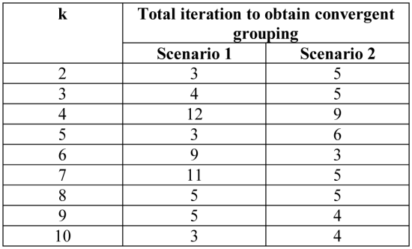
Table of number of Cluster and Iteration that are required to converge

Slide 14
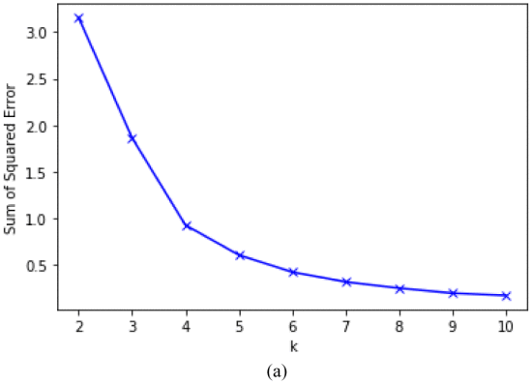
Elbow Method for Scenario 1 (without min_df)

Slide 15
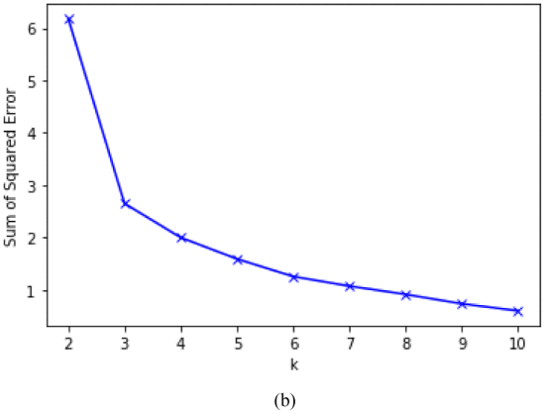
Elbow Method Scenario 2 (min_df = 10)

Slide 16
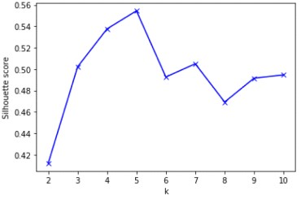
Silhouette Coefficient Method for Scenario 1 (Without min_df)

Slide 17
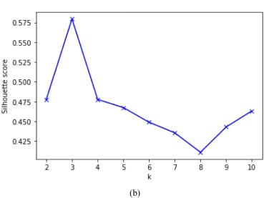
Silhouette Coefficient Method for Scenario 2 (min_df = 10)

Slide 18
Conclusion
The effect of setting minimum document frequency on the weighting step affects the result each cluster receives, in this research scenario 2 with a minimum document frequency of 10 words shows a better result.
On the second scenario, it is found that cluster evaluation result using a consistent Elbow and Silhouette Coefficient method refers to an optimum value of k=3, and with a small amount of clustering iteration of 5 iterations.
The smaller the produced dimension is during weighting, the better the clustering result obtained will be.
Although, the silhouette of both scenarios is still at around 0.5, which means that grouping is still not done perfectly because a good value is the one that approaches 1.

